Slide 1
Spatial Archive
Thomas Klein, Rohan Chandrasekar, Mya Chappell

Slide 2
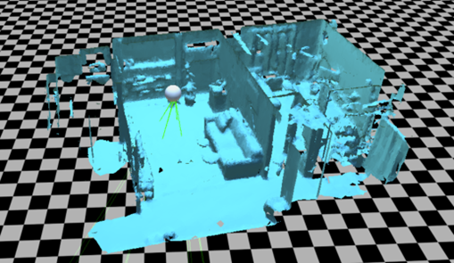
Objective: Store and Visualize Spatial Mapping Data
Benefits:
Monitoring for construction sites
Used by other devices (e.g. robots, drones, etc.)

Slide 3
Project Changes
Before:
Writing a client that can send meshes from the HoloLens and also receive meshes from server.
Writing a server that can take multiple connections and answer the upload and download requests from the clients
Now:
Utilizing MongoDB as the database solution for storing and retrieving meshes
Reasons for change:
Complexity in creating networking solution from scratch
Desire to do further work and analysis on meshes created from HoloLens

Slide 4
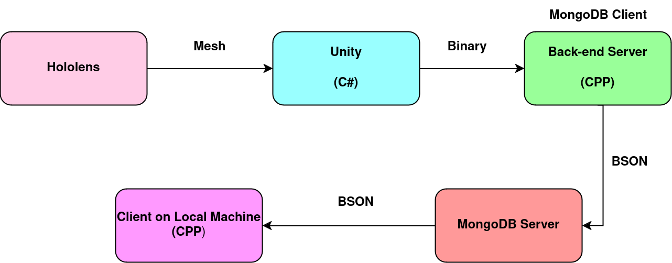
New Architecture

Slide 5
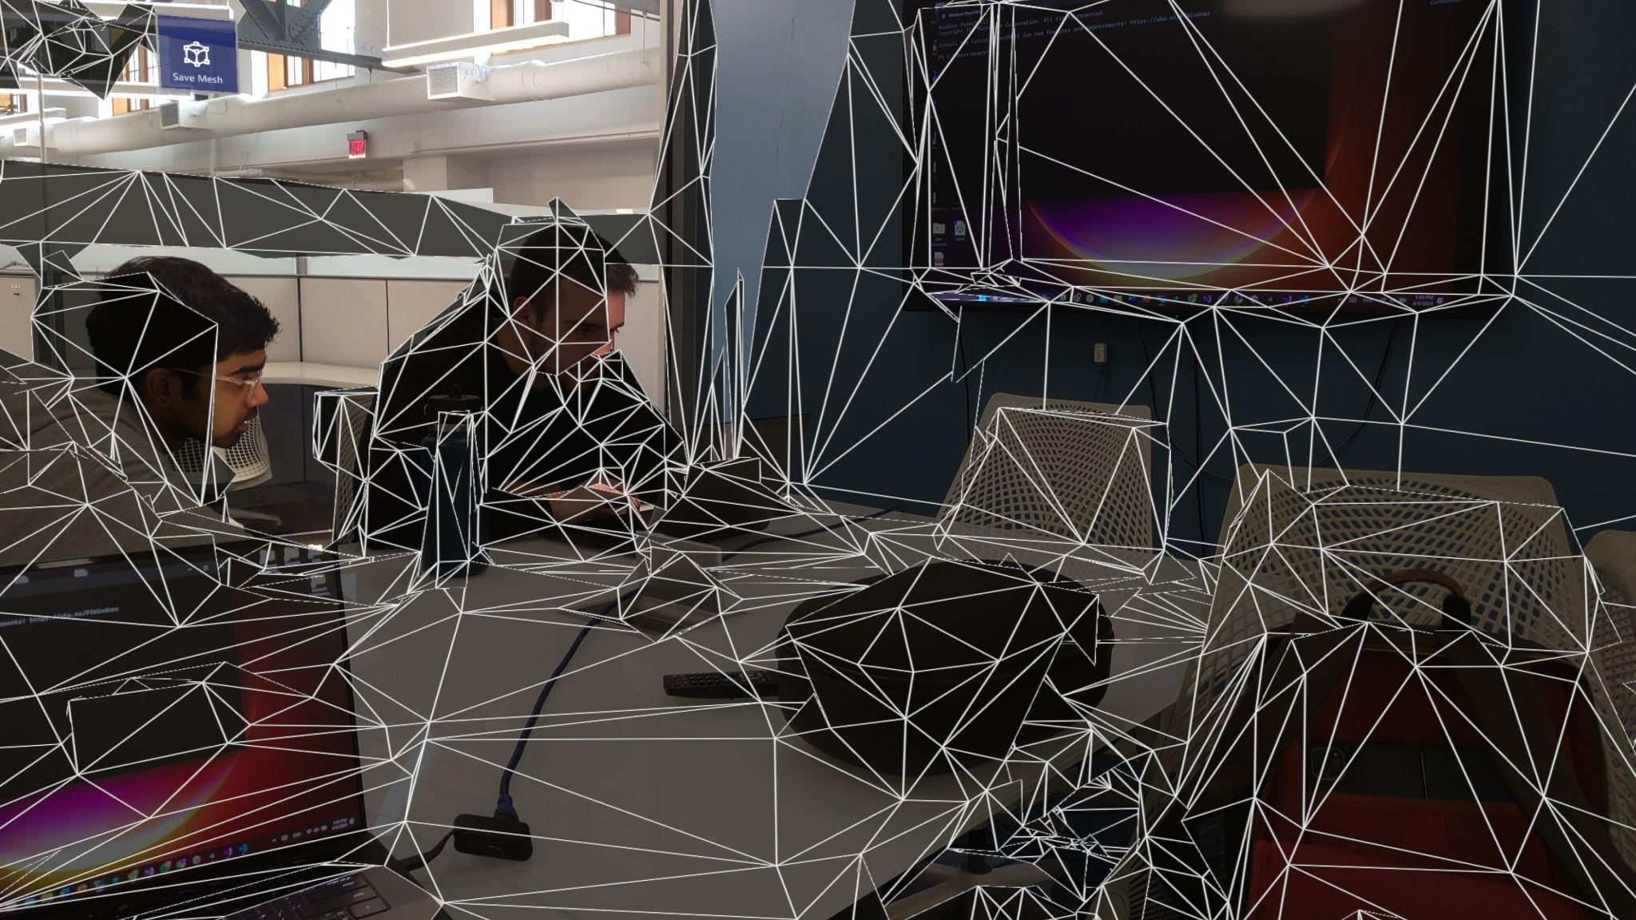
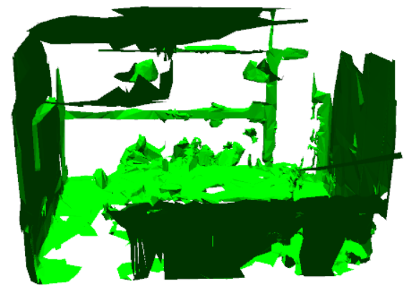
Results

Slide 6
Next steps for achievement
Focus switching to mesh analysis and refinement
Current meshes have artifacts, aren’t smooth, and not easily viewable due to occlusions
We want to trim extraneous and irrelevant polygons
We want to be able to remove, or make translucent, walls or ceilings that are hiding the useful features of the room
Extensions:
Provide mesh segmentation based on user input that is capable of distinguishing separate objects within the mesh
Adding a GUI on the local machine to view and download meshes

Slide 7

MongoDB
MongoDB is a cross-platform document-oriented database.
Allows data to be accessed by any device using the connection string
Is able to store large data files such as a mesh file

Slide 8

System Architecture
HoloLens:
Acquires the mesh filter data
Serialize mesh data into a byte array
Sends binary array to backend server
Backend Server:
Receives binary data from HoloLens
Assigns unique ID and timestamp to data
Connects and saves mesh data on MongoDB as a document
User Interface:
Lists all mesh data documents’ ID’s
Accepts user input to select mesh data by ID or timestamp
Renders the selected mesh data using OpenGL

